Slide 1
M.KUMARASAMY COLLEGE OF ENGINEERING , DEPT OF CSE – B.E
Class : III CSE A
Batch no : 15
Date : 09.09.2023

Slide 2
Fraudulence Detection In College Transport
ABUBAKKAR A I
ANU PRASANTH S
DHANUSH KUMAR S
KANNAN S
Name of the Candidates :
Register Numbers :
927621BCS005
927621BCS010
927621BCS022
927621BCS051
Name of the Supervisor :
with Designation
Ms. T.PRIYANKA

Slide 3
Objectives of the Project
The project's goal is to minimize manpower and work in an efficient manner, as well as to reduce the job of conductors and worker salaries.
It identify the perpetrators who are all cheating the college management by using duplicate ID cards.
Our suggested technology reads the identification card and category pupils.

Slide 4
Literature Review
Dr.s.Ravichandran’s research paper is about the smart ID card in the corporate world and in colleges,universities. The ID card has been become the part of the dress code.
This identity has multiple features for the user comfort, thus leads to the coining of the term smart identity.
This card discliosed in the present invention provides prepaid wallet system that keeps track of all the payment through mobile application and in addition it provides the access control authorization for the user.

Slide 5
Existing System Architecture-Findings
.
The existing system included counterbalancing with weights, hydraulic systems for controlled movement, and pneumatic systems using compressed air. Sensors like infrared, pressure plates, and proximity sensors were also employed.
Manual activation through buttons or levers was another common method.
These methods lacked the precision and customization options offered by modern microcontroller-based systems

Slide 6
Proposed System Architecture
Entry point
Receive the serial
Is the serial authorized
Access denied
Access granted
Save the check-in

Slide 7
Proposed System Architecture
The proposed system based on an Arduino board consists of a microcontroller at its core, overseeing the entire operation.
Sensors, such as a motion sensor (PIR) and ultrasonic sensor, detect movement and measure distances.
A servo or DC motor serves as the actuator to physically open and close the door.
The microcontroller processes sensor data to determine whether to operate the door.
For added safety, additional sensors like infrared or pressure sensors can be integrated.

Slide 8
Modules in Project
Synopsis:
Detecting serial number
Processing the serial number
Making decision

Slide 9
Summary of Module -1
Scanning
RF-id
Reading the serial number
Sending it to the arduino processor

Slide 10
Summary of Module -2
Detecting input from user
Send to the arduino processor
Check the validity
Access granted
Access denied

Slide 11
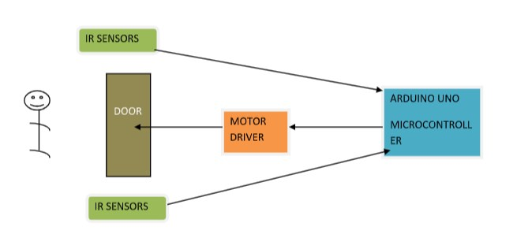
Summary of Module - 3

Slide 12
Software & Hardware Requirements Specification
Software Requirements:
Arduino IDE
Arduino Libraries
Hardware Requirements:
Arduino Board
Servo Motor
Jumper cable
Bread board

Slide 13
Partial Implementation of Modules
Here put the photo of project

Slide 14
Conclusion
In summary, the Arduino-based automatic door opening is achieved through the integration of sensors and actuators, we've created a responsive system that enhances convenience and addresses safety concerns.
The project's adaptability and potential for remote control showcase the versatility of Arduino boards in real-world scenarios.
Overall, it exemplifies the innovative possibilities afforded by open-source hardware.

Slide 15
Reference
https://www.elprocus.com/rfid-based-projects/
https://www.iosrjournals.org/iosr-jce/papers/Conf.17031-2017/Volume-2/1.%2001-06.pdf
https://www.arduino.cc/reference/en/

